Slide 1


SFRA Session

Slide 2
Topics
Introduction to Middleware in Express

Slide 3
What is Express Middleware?
Middleware literally means anything you put in the middle of one layer of the software and another. Express middleware are functions that execute during the lifecycle of a request to server.
Middleware functions have access to the request object (req), the response object (res), and the next middleware function in the application’s request-response cycle. The next middleware function is denoted by a variable named next
Middleware functions can perform the following tasks:
Execute any code.
Make changes to the request and the response objects.
End the request-response cycle.
Call the next middleware in the stack.

Slide 4
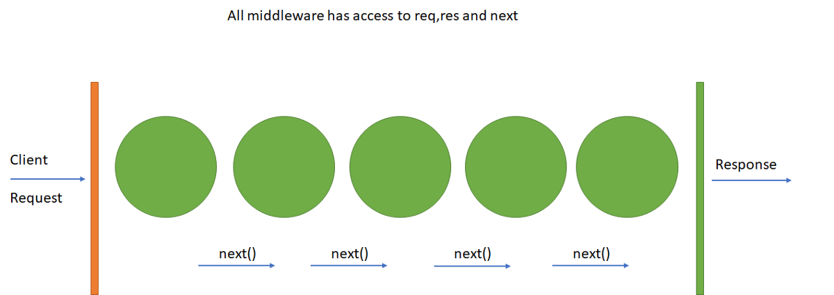
Middleware – Contd..

Slide 5
Important Points
Middleware functions have 3 standard params req, res, and next. The first two are objects, the last is a function that will call the next middleware function.
Usually there is a middleware chain, meaning a chain of functions that are called one after the other, with the last function sending the response back to the browser.
If the current middleware function does not end the request-response cycle, it must call next() to pass control to the next middleware function. Otherwise, the request will be left hanging
Any changes made to req or res object will be available in the next middleware function.

Slide 6
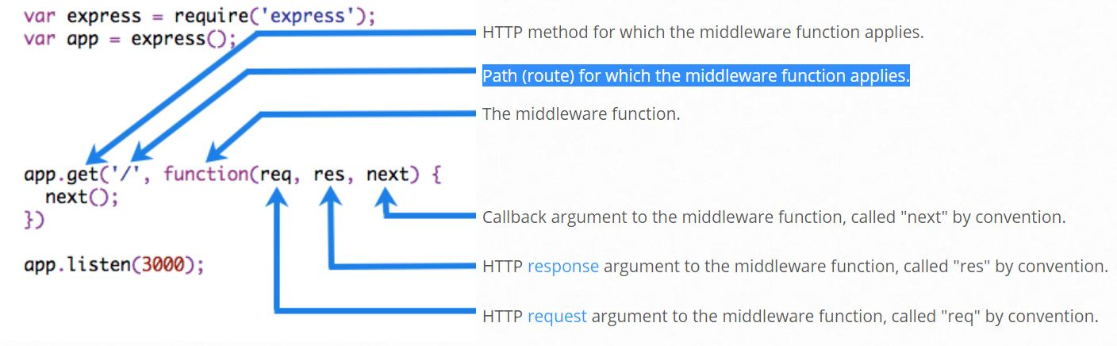
Middleware - Example
The following code example shows the elements of a middleware function call:

Slide 7
Middleware – Example Contd…
Here is a simple example of a middleware function called “myLogger”. This function just prints “LOGGED” when a request to the app passes through it. The middleware function is assigned to a variable named myLogger
var express = require('express');
var app = express();
var myLogger = function (req, res, next) {
console.log('LOGGED')
next()
};
app.get('/', myLogger, function (req, res) {
res.send('Hello World!')
});
app.listen(3000);

